Slide 1

Email Marketing

Slide 2
WHY EMAIL?

Slide 3
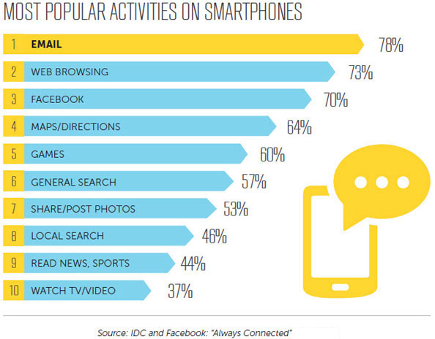
More effective than social media

Slide 4
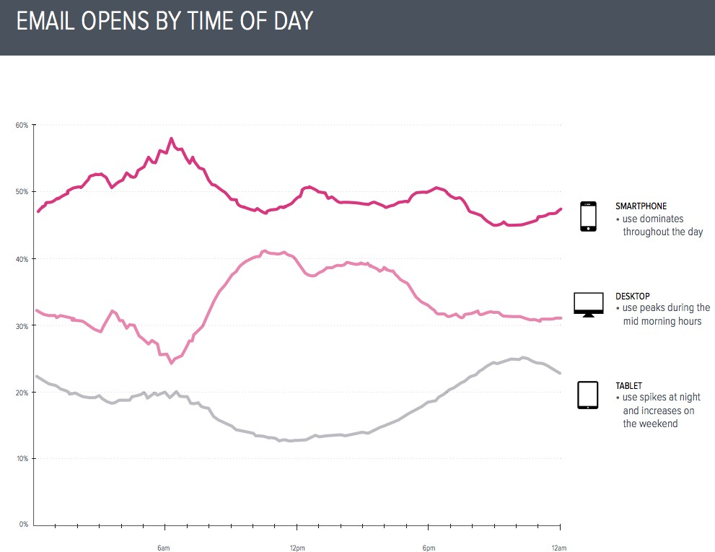
Email is read on the phone

Slide 5
It’s massive
There are 3.2 billion email accounts
Emails have a longer lifespan than social media
Email marketing has an ROI of 4300%

Slide 6
EMAIL MARKETING SERVICES

Slide 7




Services

Slide 8
Why we prefer MailChimp
MailChimp is a marketing automation platform and an email marketing service and a trading name of its operator, Rocket Science Group, an American company founded in 2001. MailChimp began as a paid service and added a freemium option in 2009
CEO: Ben Chestnut
Free • Slick • Easy • Powerful

Slide 9
EXECUTION

Slide 10
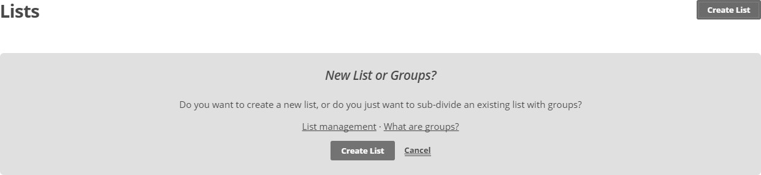
Setting up a list

Slide 11
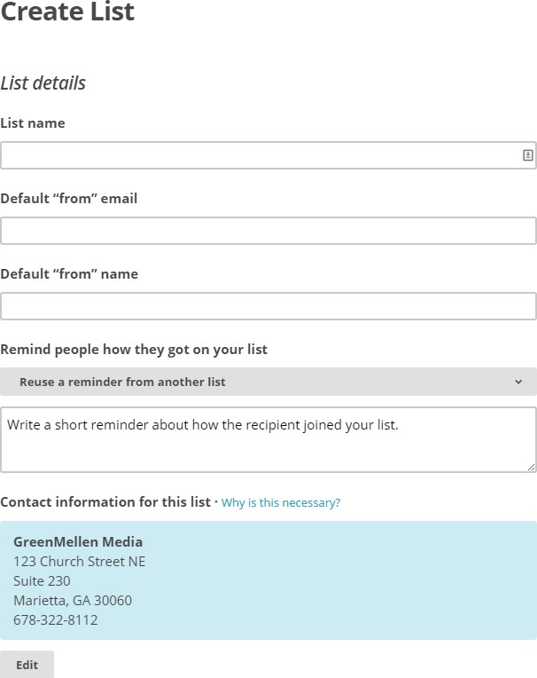
Setting up a list
First you have to sign up with you email by adding new user name and password.
If you have already have a mail chimp account login to your account using your mail id and mail chimp password.

Slide 12

How to Create a email list
First you have to create subscribers list.
List is the place where your subscribers are stored.
Click on Lists to add a new list of subscribers.
Make sure you have the subscribers data with you.
The data should be in Excel CSV format.
If you have already uploaded the list you can directly create a campaign.

Slide 13
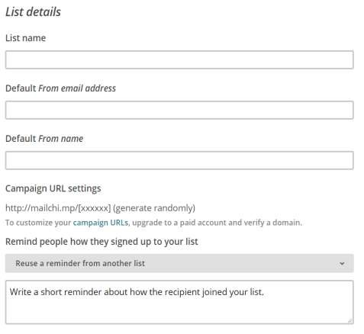
How to Create a email list
We have to give a name to the list related to your campaign
Then we have to enter a mail id, the mail id should represent your business because this mail id will shown to the subscribers.
Enter your business name to let the subscriber know from whom he /she getting this e mail.
We have to give a note to the subscribers, how
we are connected to them.
Reminder is mandatory

Slide 14
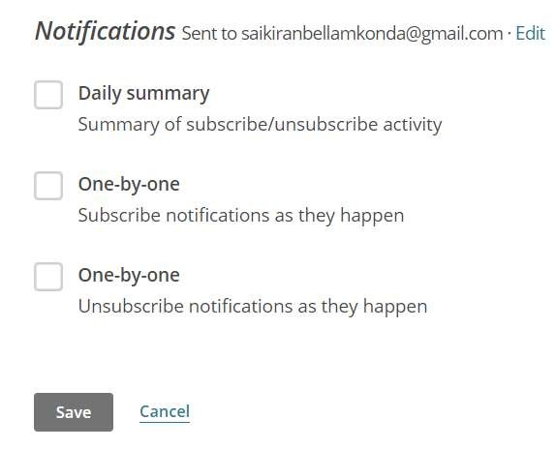
How to Create a email list
Below the reminder you will find the notifications
If the recipient subscribe/un subscribed from
your service you will get the notification
Daily Summary: You will get overall notifications at once.
One by one: you will get the notification one by
one if they subscribe
One by one: you will get the notification one by one if they unsubscribe
Click on save and continue.

Slide 15
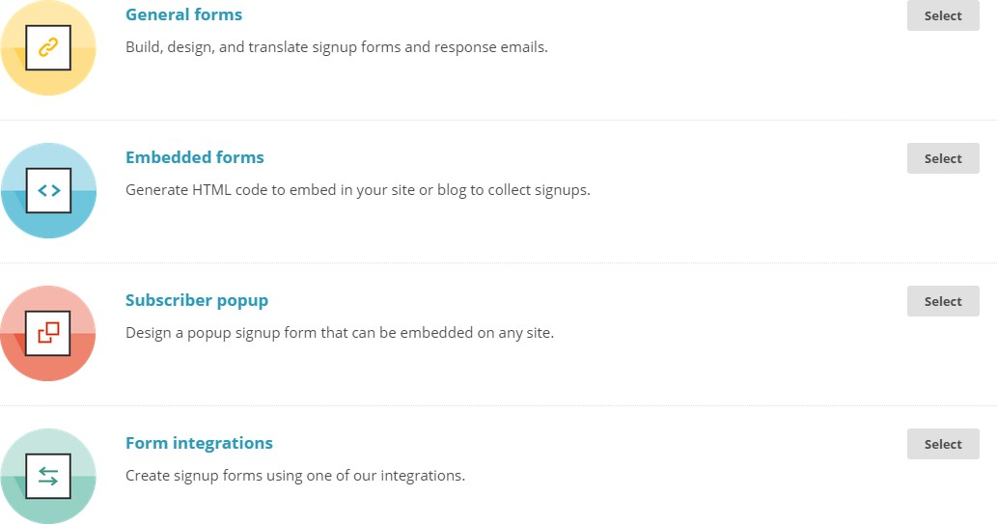
Adding a sign-up form to your site

Slide 16
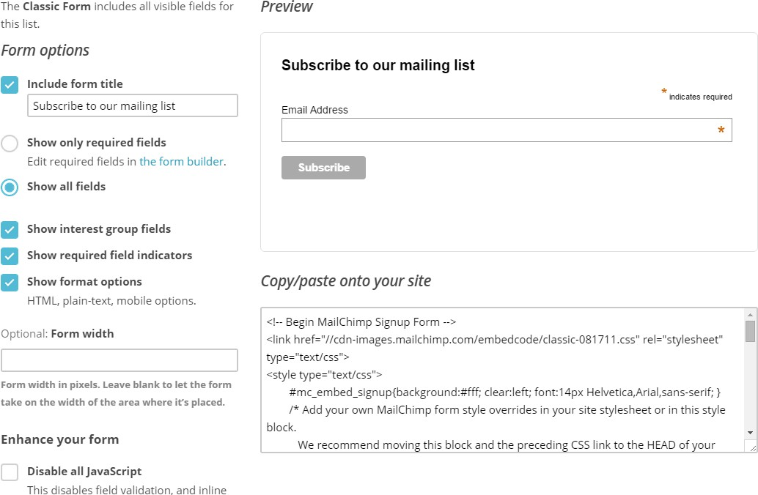
Adding a sign-up form to your site

Slide 17
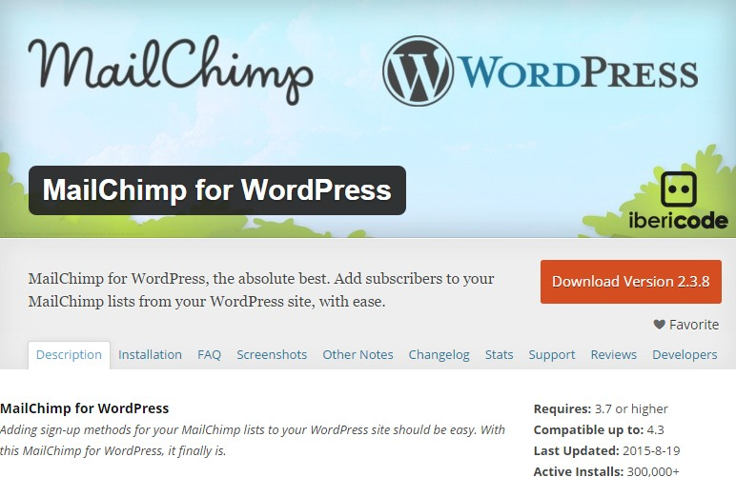
Adding a sign-up form to your site

Slide 18
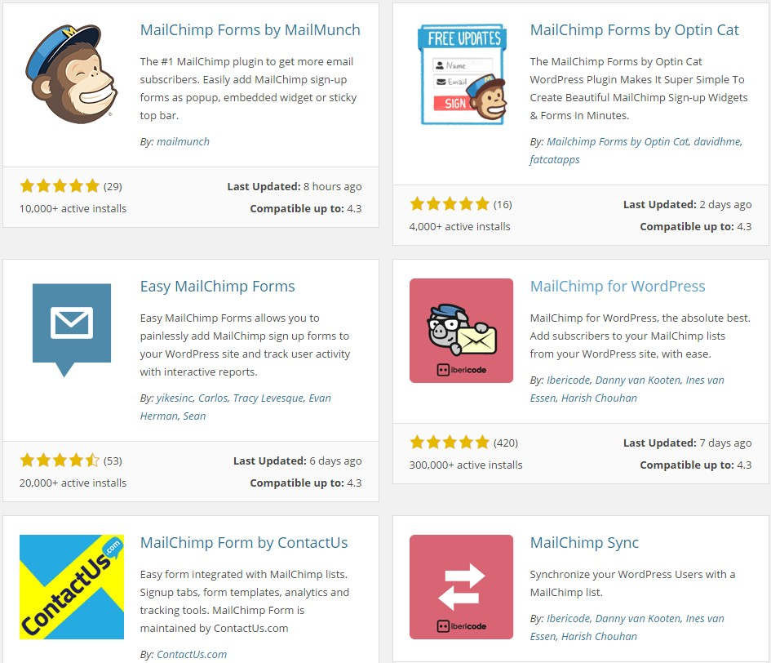
Adding a sign-up form to your site

Slide 19
SENDING

Slide 20
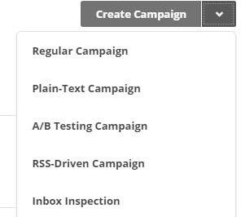
Sending a campaign from a template

Slide 21
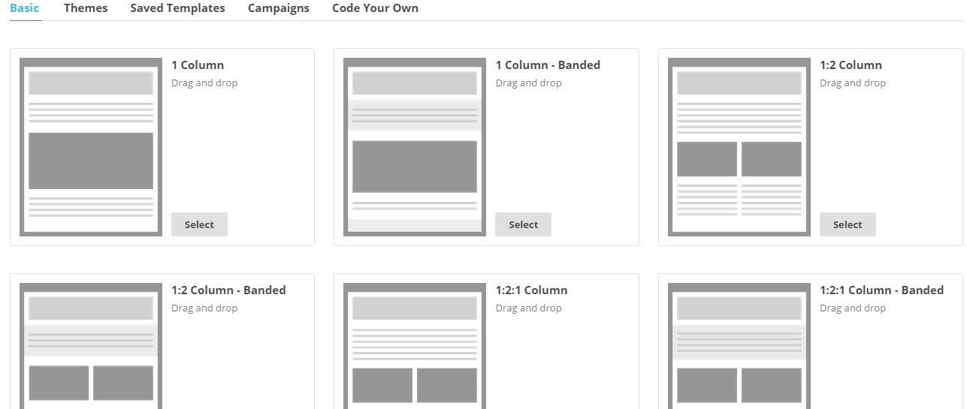
Sending a campaign from a template

Slide 22
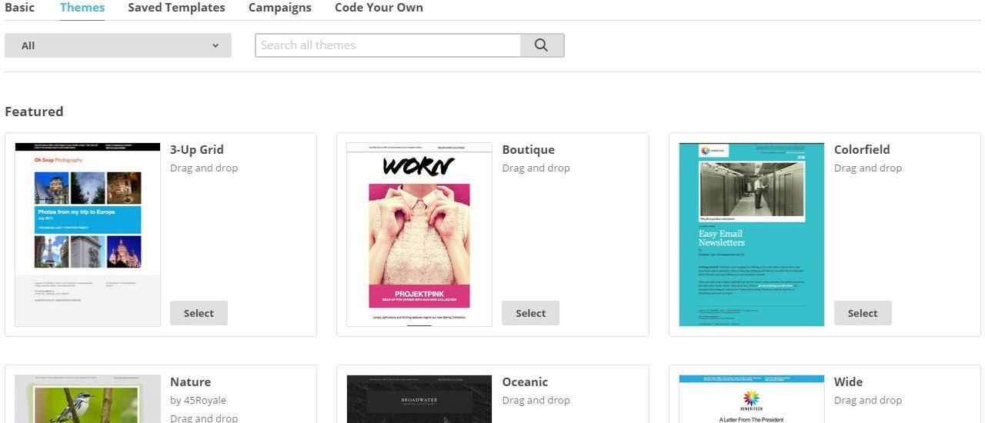
Sending a campaign from a template

Slide 23
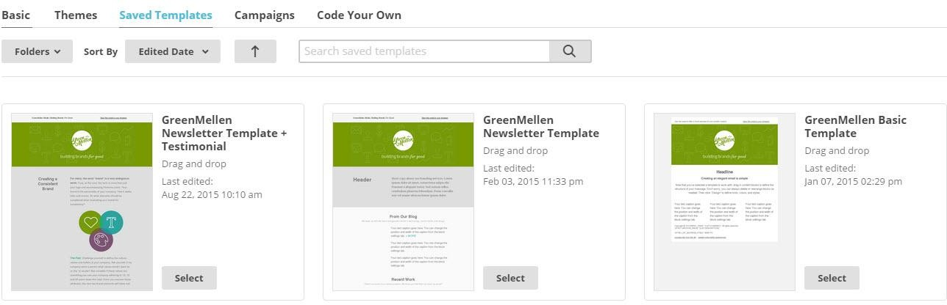
Sending a campaign from a template

Slide 24
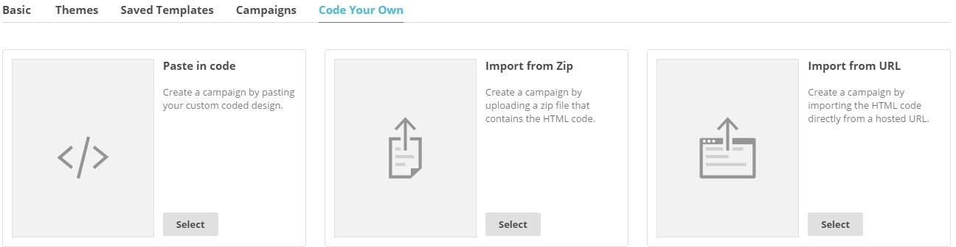
Sending a campaign using HTML

Slide 25
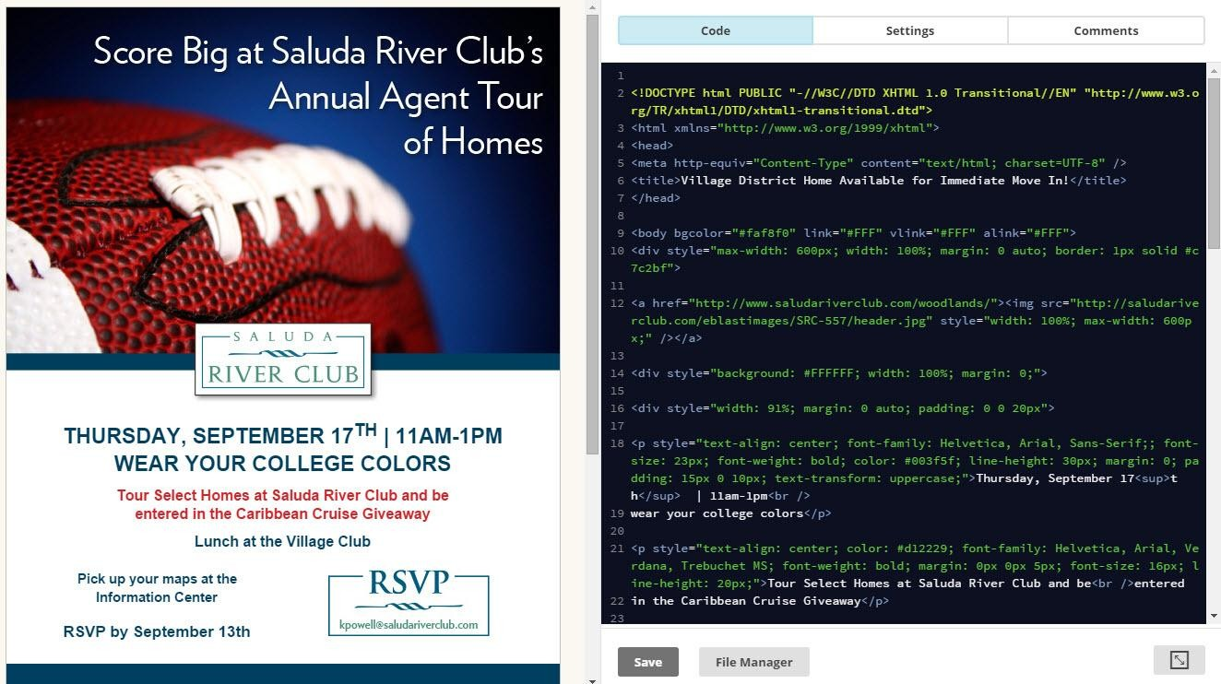
Sending a campaign using HTML

Slide 26
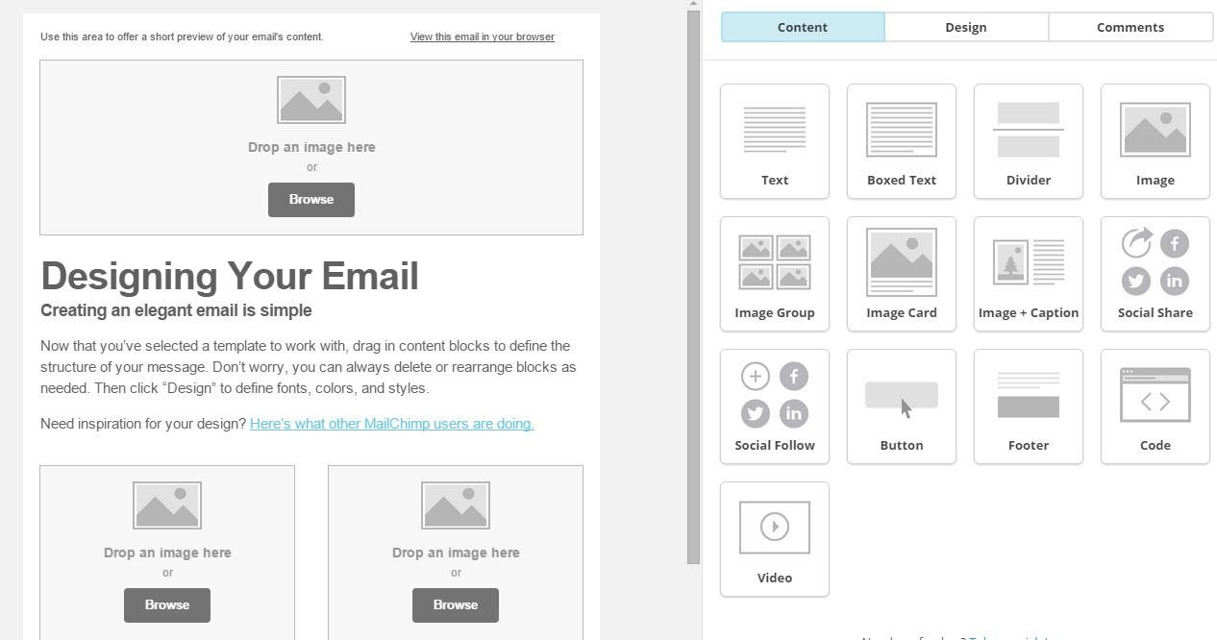
Sending a campaign from a template

Slide 27
Sending a campaign via RSS

Slide 28
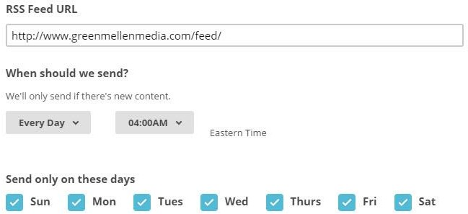
Sending a campaign via RSS

Slide 29
Sending a campaign via RSS
http://www.greenmellenmedia.com/category/seo-blog/feed/
http://www.greenmellenmedia.com/tag/wordpresstag/feed/ http://www.greenmellenmedia.com/author/ali/feed/

Slide 30

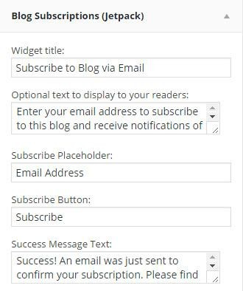
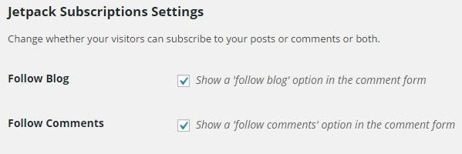
Sending a campaign via RSS

Slide 31
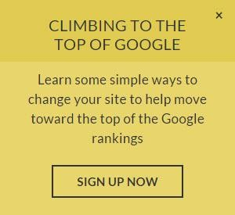
Automation

Slide 32
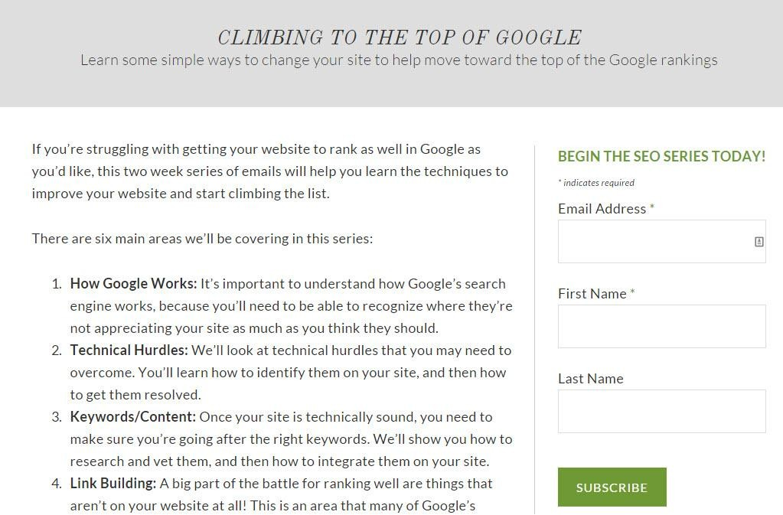
Automation

Slide 33
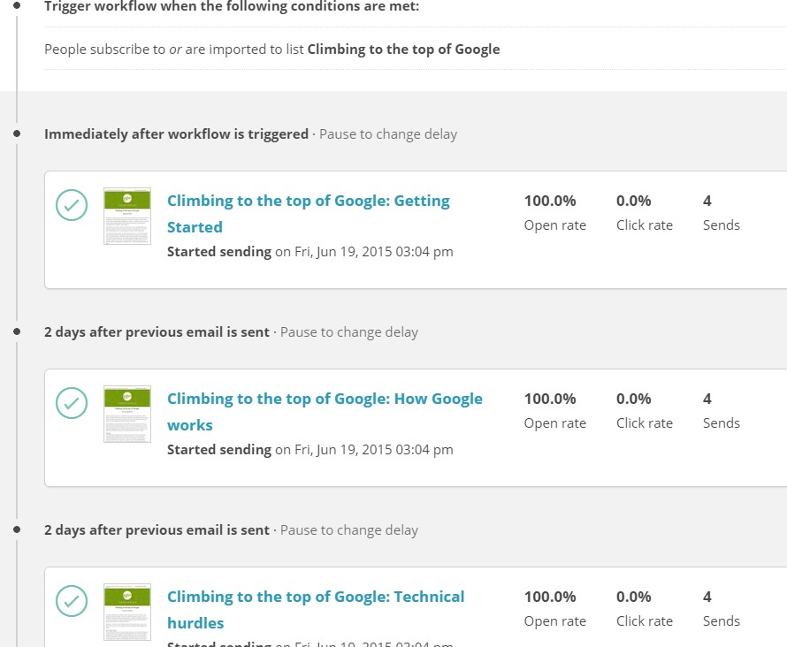
Automation

Slide 34
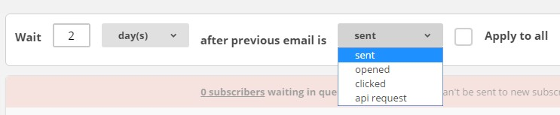
Automation

Slide 35
GETTING RESULTS

Slide 36
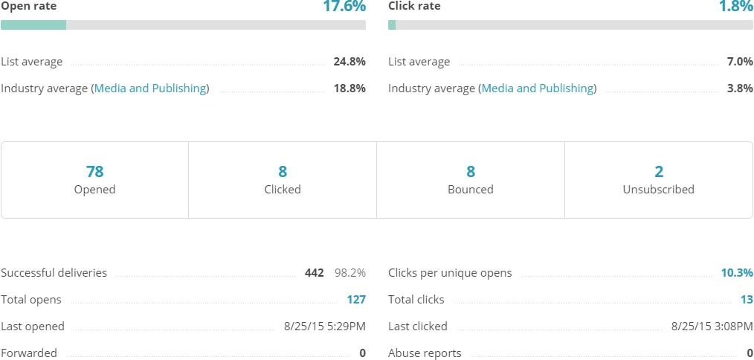
Statistics

Slide 37
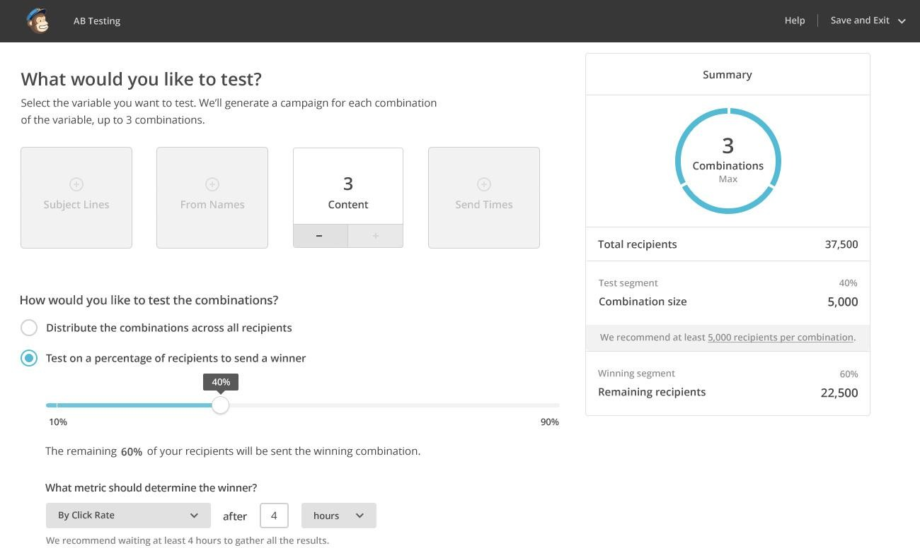
A/B Testing

